Slide 1

TESCO

Slide 2
Content
OVERVIEW
MISSION AND VISION
BUSINESS CASE SCENARIO
CLEAR IDEAS
PROBLEM SOLVING CYCLE
VALUE TREE ANALYSIS
CONCLUSION

Slide 3
Introduction
TESCO is a British multinational groceries and general merchandise retailer with headquarters in Welwyn Garden city, Hertfordshire, England, United Kingdom.
It is the third-largest retailer in the world measured by gross revenues.
It was established in 1919 founded by Jack Cohen.
It has shops across Asia and Europe and has more than 6500 plus shops.
And it has a very good revenue of 63 billion pounds as per 2019.

Slide 4
Due to covid-19 as we can expect a drastic change in there revenue this year as most of the revenue generates in the month of march where it is the extraordinary month for grocery retailers.
Before that there were enough stock in the stores no queues and easy way for the window shopping.
Now due to covid-19 it’s very difficult for the customers to go out and in this critical situation and buy the groceries.
And there was no proper stock in the stores and the line system and limited items per the particular person ruined there business where the customers have been reduced to 50% mainly the people are panicking to enter in to the shops.

Slide 5
Due to the current situation most of the people are preferring online shopping instead of window shopping.
As per our research we were getting very bad reviews for the online orders, like the delivery has been delayed or out of date products have been delivered instead of good one.
And there is no proper response from the team for the queries because they doesn’t have a proper chat bar option.
Like we are implementing chat bar option where we can get some fast reply from the particular team.

Slide 6
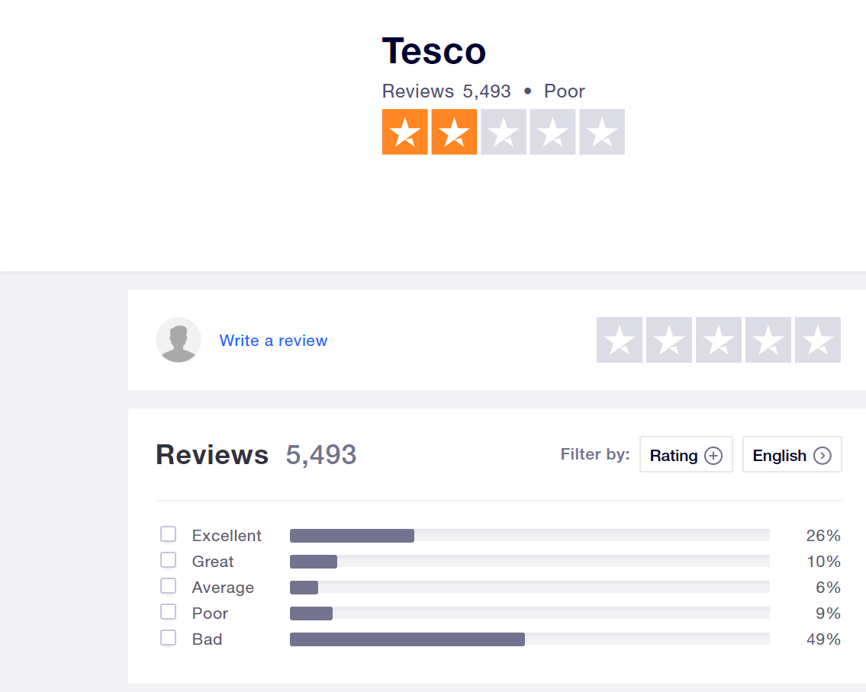

Slide 7
Problem Identification
The website needs to improve mainly on following areas:
Communication channel
Reliability issues
User satisfaction

Slide 8
Clear Ideas-Cause of problems
There is no communication tools.
Quantity of products availability in this situation.
Interoperability is limited.
User satisfaction.
Slot availability
Delivery issues.

Slide 9
Clear Ideas-to solve problems
By improving communication tools like chat box.
Increase or limit the Quantity of products availability to user in this situation.
Interoperability is limited.
Try to improve user satisfaction.
Remove slot availability option, instead go with limit of products for each user.
Resolve delivery issues.

Slide 10
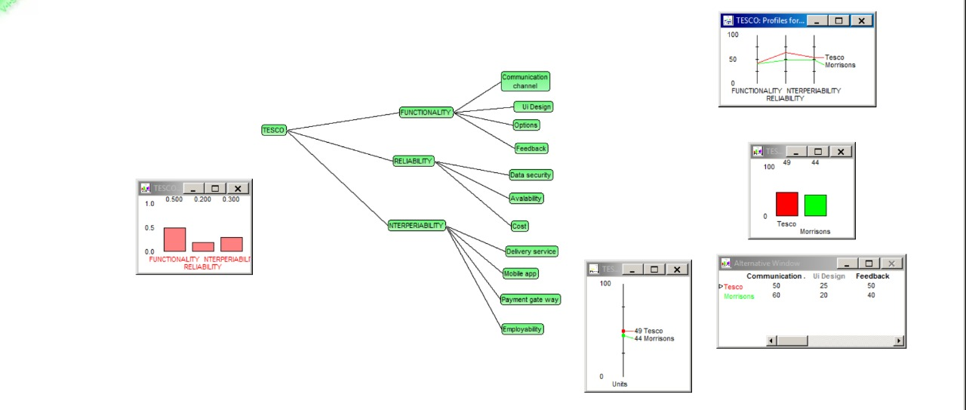
VISA

Slide 11
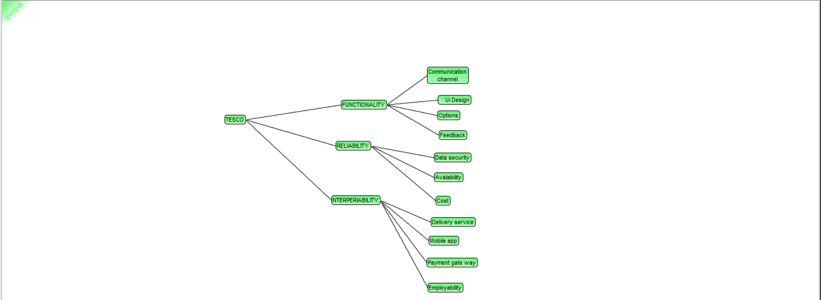
VISA

Slide 12
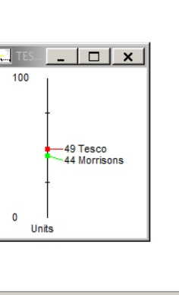
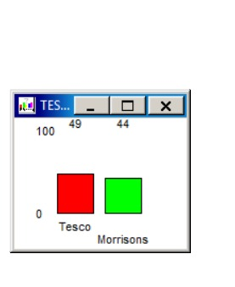
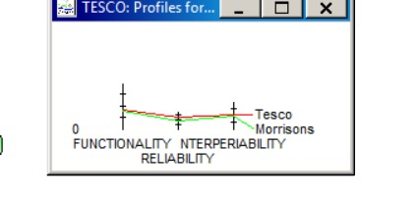
VISA-Alternatives

Slide 13
Recommendations and Conclusion
Through the VISA Application and based on the research done we recommend the Tesco need to maintain the effective use of communication on its Application by introducing and implementation of tool known as chat Box.
· For Tackling the reliabity issues a robust application for Tesco which results the application to perform even when unexpected or unanticipated events occur like covid19 Pandemic.
· Increasing the stock levels of basic necessities of food and essential can make the tesco to surge in its slots booking availability for vulnerable. Due to ‘one-in , one-out’ system in its stores making people to get the home deliveries in larger number can solve the crisis.
· Implementation costs are low and the responsive time will be quicker.
· Improvements make the online system for tesco simpler and build good customer relation at the time of this pandemic

Slide 14
Thank you…
Laxmi Prasanna Kakkerlla
Pravalika
Rohit
chinni

